Slide 1
Bike Store Relational Database
Leveraging Data for Business Insights
Made By – Samad Abbas
Date – 9/8/2025

Slide 2
Index
1 | Problem Statement
2 | Introduction & Project Overview
3 | Dataset Overview
4 | Key Business Questions & SQL Queries
5 | Learnings & Challenges
6 | Conclusion & Future Work

Slide 3
Problem Statement
-> Context:
-> A growing chain of bike stores operates across multiple locations, managing a diverse inventory of products ,processing numerous customers orders, and employing a dedicated staff. Currently ,the business relies on disparate operational data stored in various Csv files ,lacking a unified and easy query able system for comprehensive analysis

Slide 4
Introduction & Project Overview
-> What is this project about?
-> Analyzing sales , customer, product ,brands, staffs, stores, categories and inventory data for a bike store chain
-> Objective:
-> To demonstrate SQL skills in extracting , transforming and analyzing relational data.
-> To provide actionable insights for business decision – making
-> Data Source :
-> Csv files Provided – categories, customers, order_items, products, orders , stocks , stores , staffs and brands

Slide 5
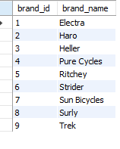
Dataset Overview
Brands
-> Columns: brand_id and brand_name
2) Categories
-> Columns: Category_id and Category__name

Slide 6
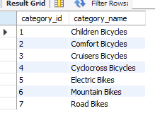
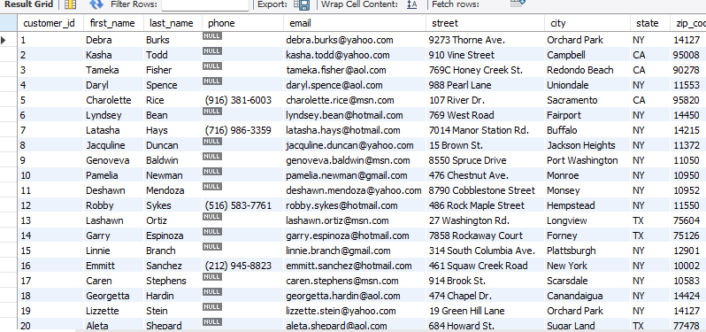
3)Customers
-> Columns : customer id, first_name, last_name , phone, email, street, city, state, zip_code.

Slide 7
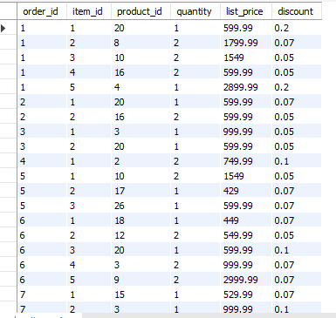
4) Order_items
->order_id, item_id, product_id, quantity, list_price, discount
5) Orders
-> Columns: order_id , customer_id, order_status , order_date, required_date, shipped_date, store_id, staff_id

Slide 8
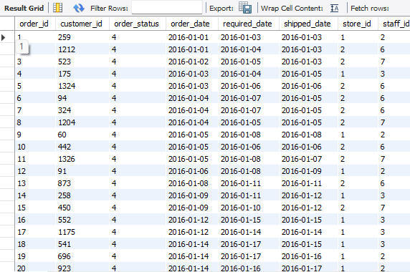
6) Products
-> Columns: product_id, product_name, brand_id, category_id, model_year, list_price

Slide 9
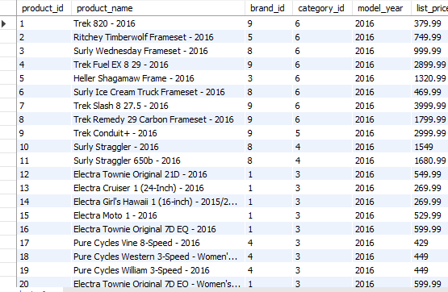
7) Staffs
-> Columns: staff_id, first_name, last_name, email, phone, active, store_id, manager_id

Slide 10
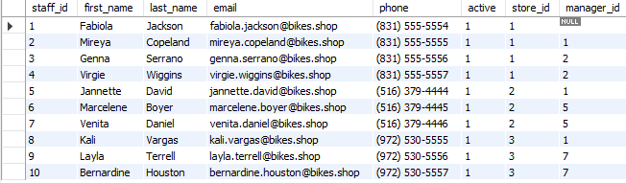
8) Stocks
-> Columns: store_id, product_id, quantity

Slide 11
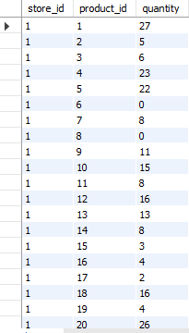
9) Stores
-> Columns: store_id, store_name, phone, email, street, city, state,zip_code

Slide 12


Slide 13
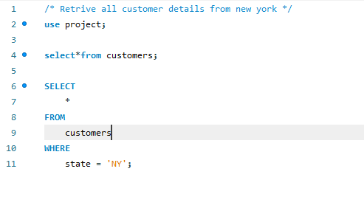
Key Business Questions & SQL Queries
-> Retrieve all customer details from New York State.
-> This query selects all columns from the customers table where the state is ‘NY’

Slide 14
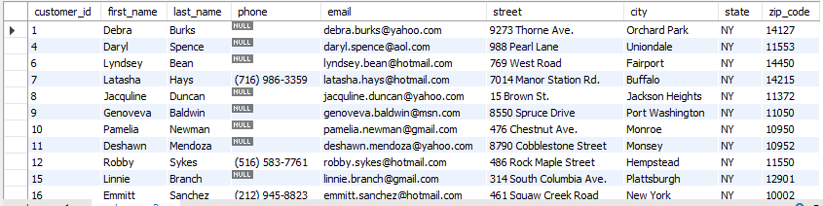
-> Retrieve all customer details from New York State.
OUTPUT

Slide 15
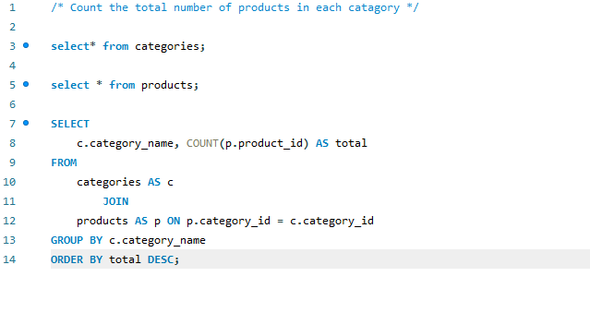
-> Count the total number of products in each category.
-> This query joins products and categories tables , groups the result by category_name, and counts the number of products in each group

Slide 16
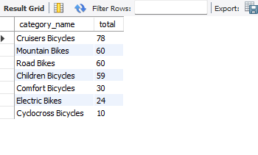
-> Count the total number of products in each category.
OUTPUT

Slide 17
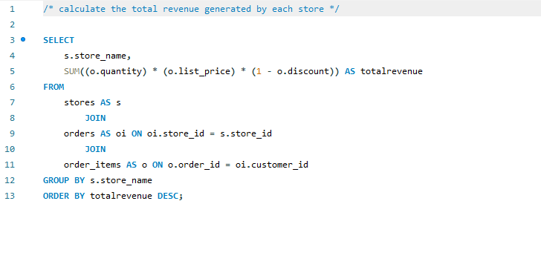
-> Calculate the total revenue generated by each store.
-> This query involves joining stores ,orders and order_items tables . It calculates the revenue for each item (quantity * list_price *(1-discount)) and then sums it up for each store

Slide 18
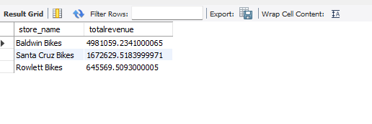
-> Calculate the total revenue generated by each store.
OUTPUT

Slide 19
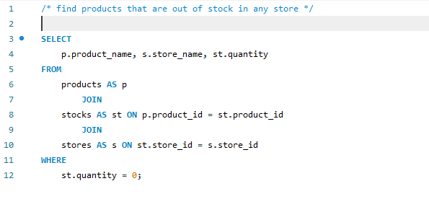
-> Find products that are out of stock in any store.
-> This query identifies products that have a quantity of 0 in the stocks table.

Slide 20
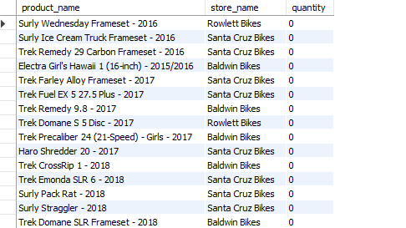
-> Find products that are out of stock in any store.
OUTPUT

Slide 21
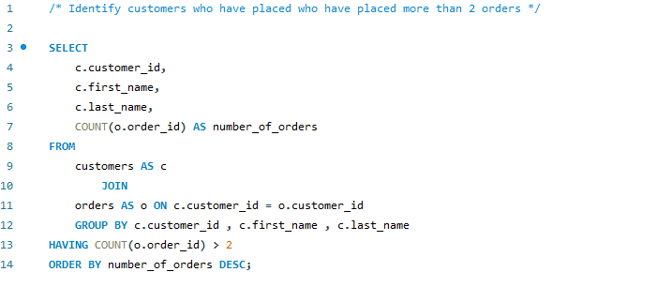
-> Identify customers who have placed more than 2 orders.
-> This query joins the customers and orders tables , groups by customers , and then filters to show only customers with more then 2 orders .

Slide 22
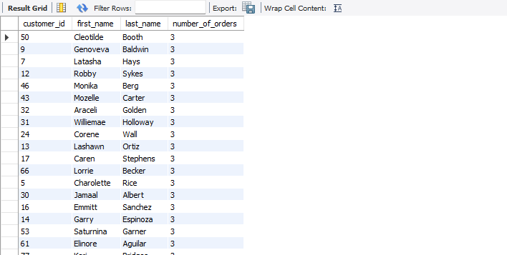
-> Identify customers who have placed more than 2 orders.
OUTPUT

Slide 23
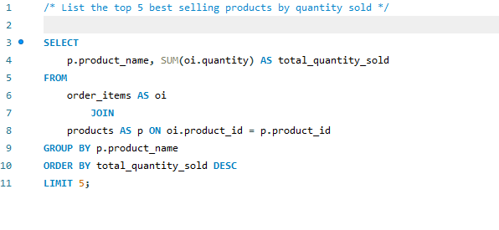
-> List the top 5 best selling products by quantity sold .
-> This query joins order_items and product ,sums the quantity for each product ,and orders them in descending order to find the top 5 .

Slide 24
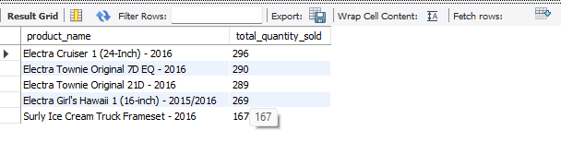
-> List the top 5 best selling products by quantity sold .
OUTPUT

Slide 25
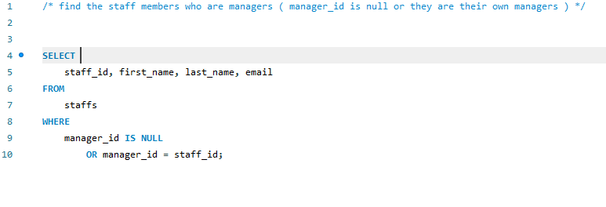
-> Find the staff members who are managers ( manager_id is null or they are their own managers ) .
-> This query identifies staffs members who have a NULL .value in their manager_id
Column ,indicating they are likely top- level managers or whose manager_id is the same as their staff_id

Slide 26
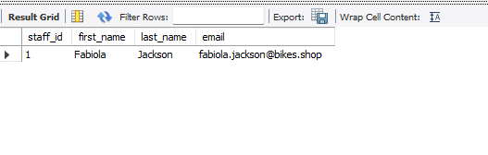
-> Find the staff members who are managers ( manager_id is null or they are their own managers ) .
OUTPUT

Slide 27
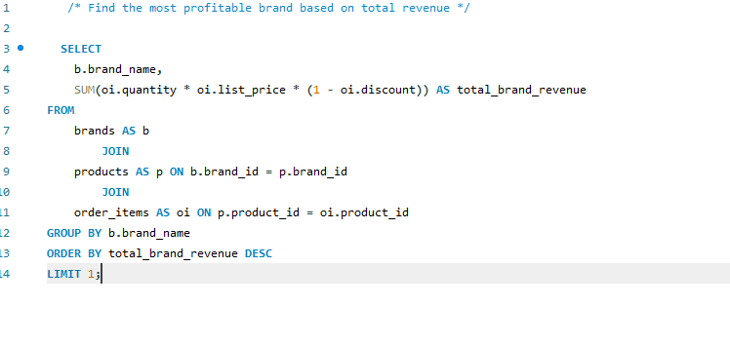
-> Find the most profitable brand based on total revenue .
-> This query calculates the total revenue for each brand by joining brands ,products ,and order_items , and then orders the results to find the brand with the highest revenue.

Slide 28
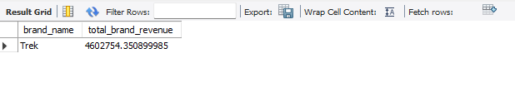
-> Find the most profitable brand based on total revenue .
OUTPUT

Slide 29
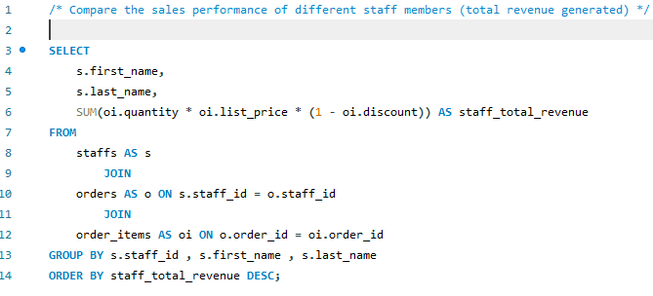
-> Compare the sales performance of different staff members (total revenue generated) .
-> This query joins staffs, orders and order_items to calculate the total revenue generated by each staff member.

Slide 30
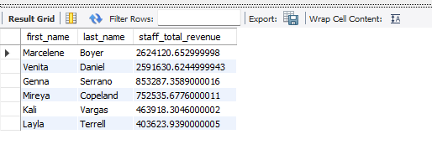
-> Compare the sales performance of different staff members (total revenue generated) .
OUTPUT

Slide 31
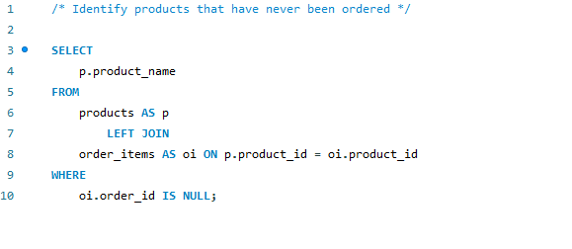
-> Identify products that have never been ordered.
-> This query uses a Left Join to find products that do not have a matching entry in the order_items table .

Slide 32
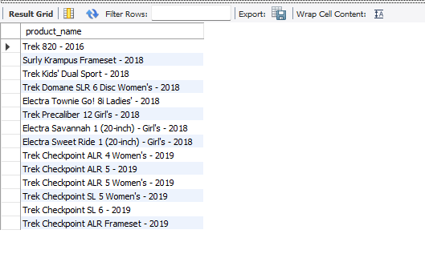
-> Identify products that have never been ordered.
OUTPUT

Slide 33
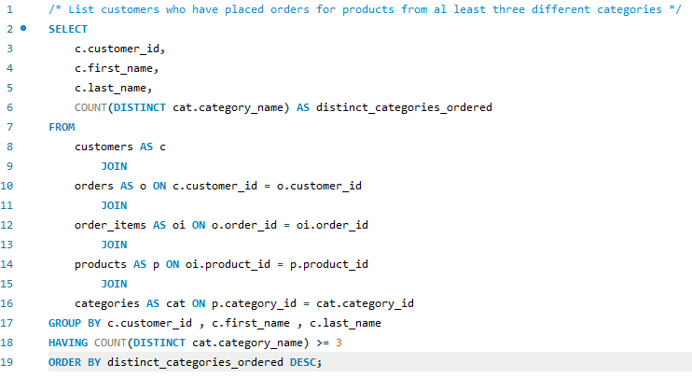
-> List customers who have placed orders for products from al least three different categories.
-> This query involves multiple joins and uses count(distinct) with having to count the unique categories ordered by each customers

Slide 34
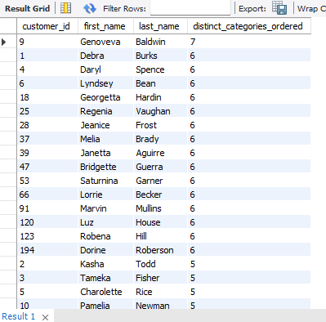
-> List customers who have placed orders for products from al least three different categories.
OUTPUT

Slide 35
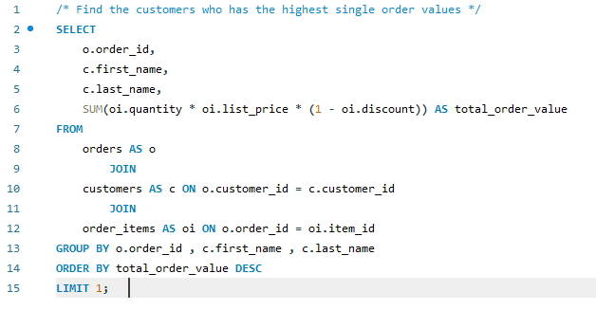
-> Find the customers who has the highest single order values.
-> This query uses a subquery to first calculate the total value for each order , and then finds the maximum of those values .

Slide 36
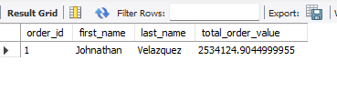
-> Find the customers who has the highest single order values.
OUTPUT

Slide 37
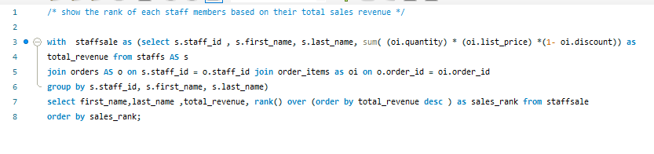
-> Show the rank of each staff members based on their total sales revenue.
-> This query uses a subquery to first calculate the total value for each order , and then finds the maximum of those values .

Slide 38
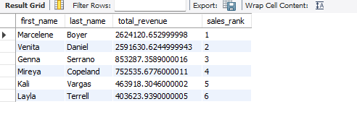
-> Show the rank of each staff members based on their total sales revenue.
OUTPUT

Slide 39
Learnings & Challenges
-> Key Learnings :
-> Importance of well-structured data .
-> Power of Joins for combining information from different tables.
-> Using aggregation (Sum, Count , Avg) for summary insights.
-> Applying Filtering ( where , Having) and odering ( Order By ).
-> Advanced techniques like Ctes and Window functions for complex analytical queries.
-> Challenges Faced :
-> Understanding table relationships.
-> Writing complex JOIN conditions .
-> Debugging SQL queries.

Slide 40
Conclusion & Future Work
-> Summary of Key Findings:
-> Reiterate 1-2 most significant insights gained.
-> Potential Future Enhancements :
-> Building a dashboard for real- time sales monitoring.
-> Integrating with visualization tools for richer insights.
-> Predictive analytics.
-> Adding more data sources .
-> Optimizing queries for large datasets.

